Slide 1
Disaster at St. Himark! Project I: Crowdsourcing for Situational Awareness
Isaac McPadden
Data Science Capstone Final Project
Background Image Credit: https://www.vecteezy.com/free-vector/epicenter

Slide 2
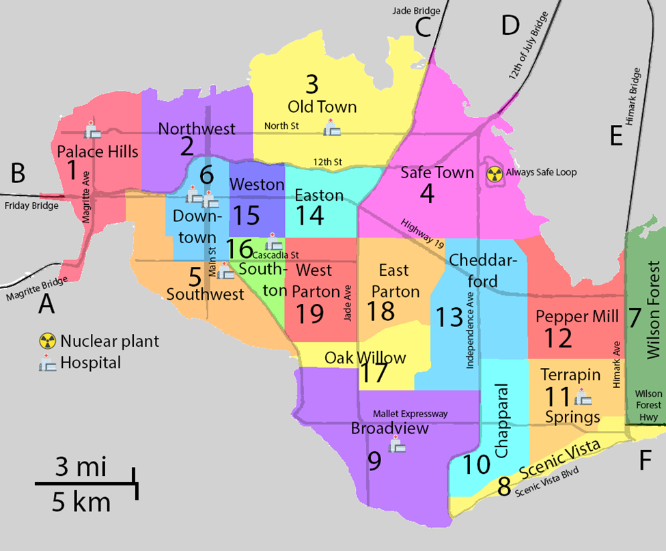
About St. Himark
Population of 246,839
Located on a Peninsula
5 Bridges and 1 Highway to the Mainland
19 Neighborhoods
8 Hospitals
34 Fire Stations for Emergency Management
Powered by the Always Safe Nuclear Power Plant and Renewables
St. Himark is in an earthquake prone area

Slide 3
The Rumble App
St. Himark recently released the Rumble App to crowdsource damage reporting in the event of an earthquake
Damage reports are recorded by time and which neighborhood the damage is observed in
Citizens can report shake intensity and damage observations in up to 5 categories
Damage categories:
Sewer and Water
Power
Roads and Bridges
Medical Facilities
Buildings
Reports are collected and recorded in 5-minute intervals
In the event of a power/internet outage, all reports are collected after the outage and recorded as though they occur at the time of restored power/internet

Slide 4
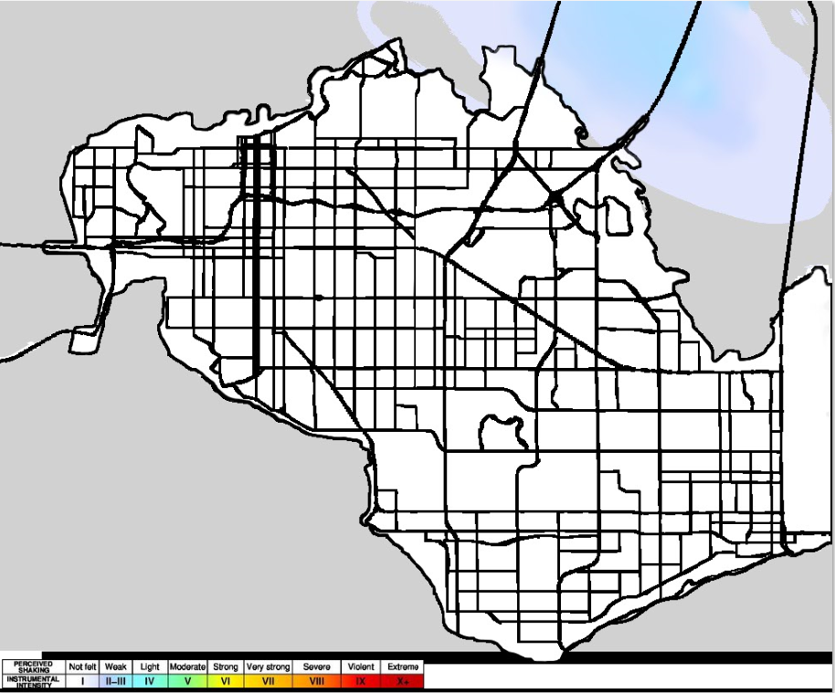
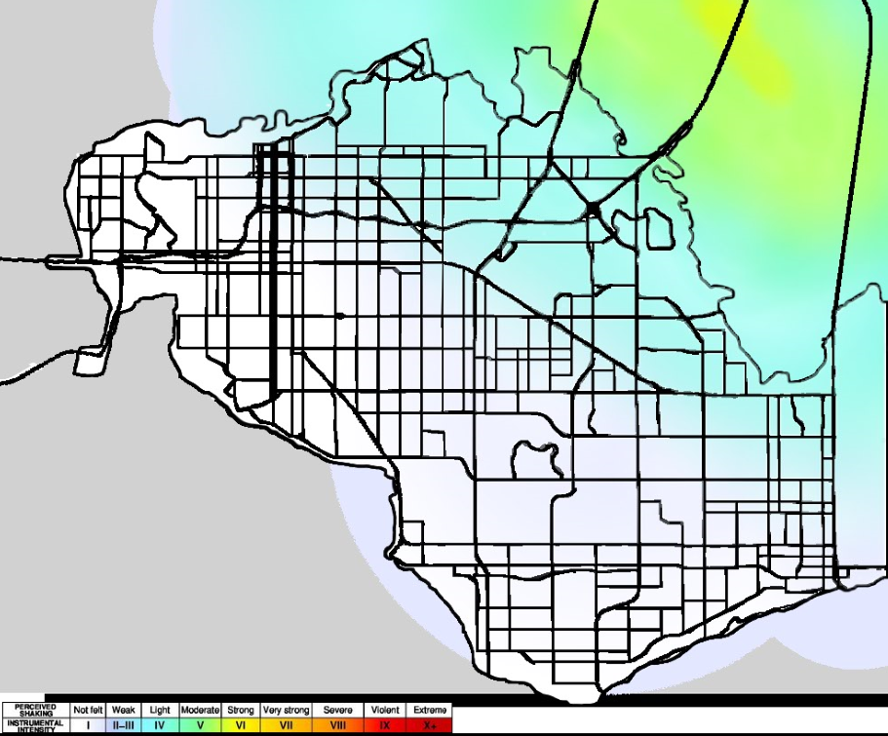
The Earthquakes
April 6th Minor Earthquake
April 8th Major Earthquake

Slide 5
Goals
St. Himark has provided data from the Rumble App from April 6th through April 10th (120 hours)
The primary goal is to use the data to prioritize which neighborhoods need emergency responders the most
Secondary goals are to determine if any areas are providing unreliable data, how emergency response needs change with time, and if reliability of data changes with time
With 34 Fire Departments with emergency response teams, the primary goal will be accomplished by determining the 34 neighborhood and damage types that require the most urgent response

Slide 6
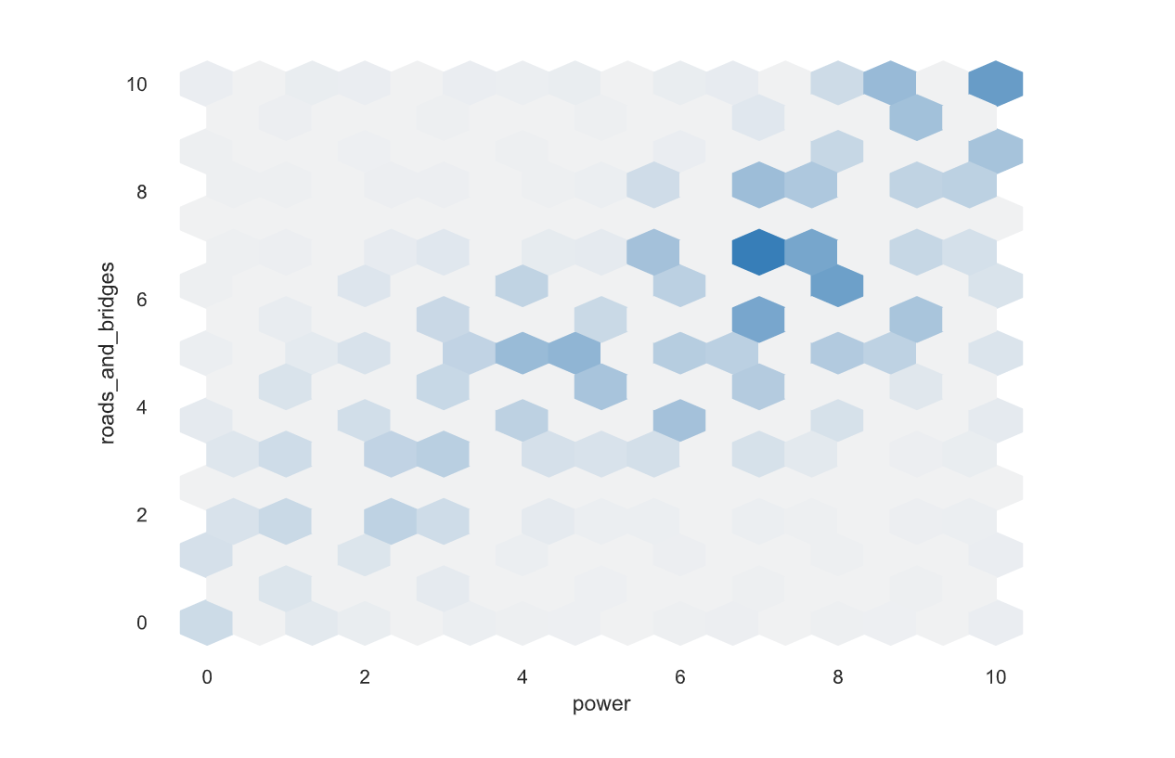

Exploratory Data Analysis
Initial Exploratory Data Analysis was performed using Pandas Profiling
General summary statistics were unremarkable, largely because they did not account for location
Interactions between damage types were linear which is unsurprising

Slide 7
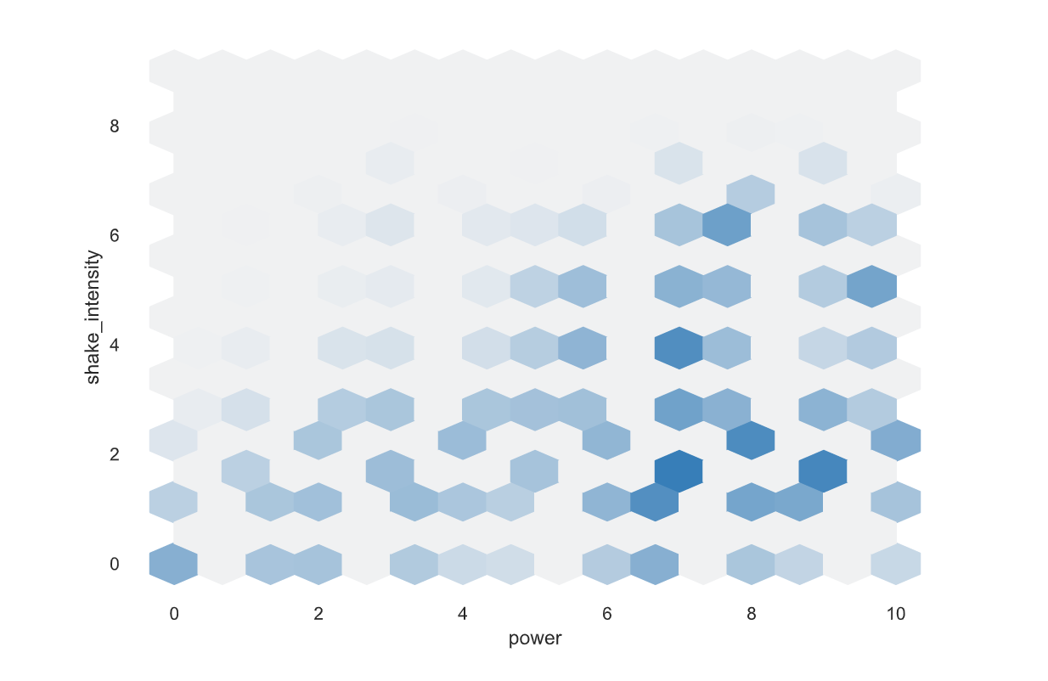
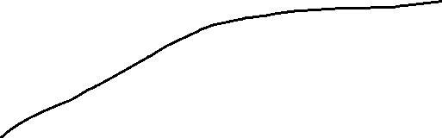
Exploratory Data Analysis
Shake intensity had a somewhat logarithmic relationship with damage reports, but not strongly correlated

Slide 8
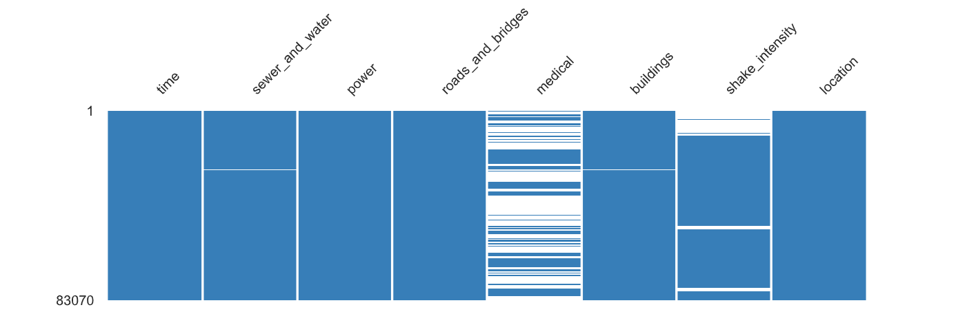
Exploratory Data Analysis
Missing values mostly occur in the medical facilities category which makes sense because there are only 8 hospitals in the city but 19 neighborhoods
The NaNs in sewer_and_water and buildings are in Neighborhood 7, Wilson Forest which has a lot of undeveloped parts
Shake intensity NaNs will come up later

Slide 9
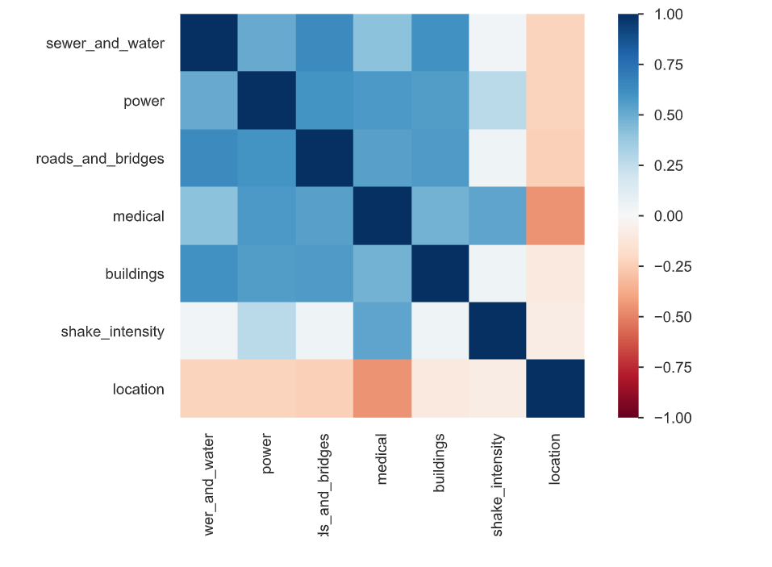
Exploratory Data Analysis
The correlation heatmap is unsurprising
Damage numbers are positively correlated with each other
Location is uncorrelated or negatively correlated but the location numbers are not ordered logically so it is not relevant
Shake intensity and damage are uncorrelated but that makes sense because the shaking is not happening over the entire 5 day period of data collection
The positive correlation of shake_intensity with medical is likely due to medical having so many NaNs

Slide 10
Splines Primer
Cubic Splines are piecewise polynomial fits to scattered data
They are smooth and continuous
A good use for them in data science is interpolation that avoids overfitting
I used cubic splines for visualization of the time series data
For the splines to be useful, data were aggregated into 1-hour intervals instead of 5-minute intervals
Source: https://pythonnumericalmethods.berkeley.edu/notebooks/chapter17.03-Cubic-Spline-Interpolation.html

Slide 11
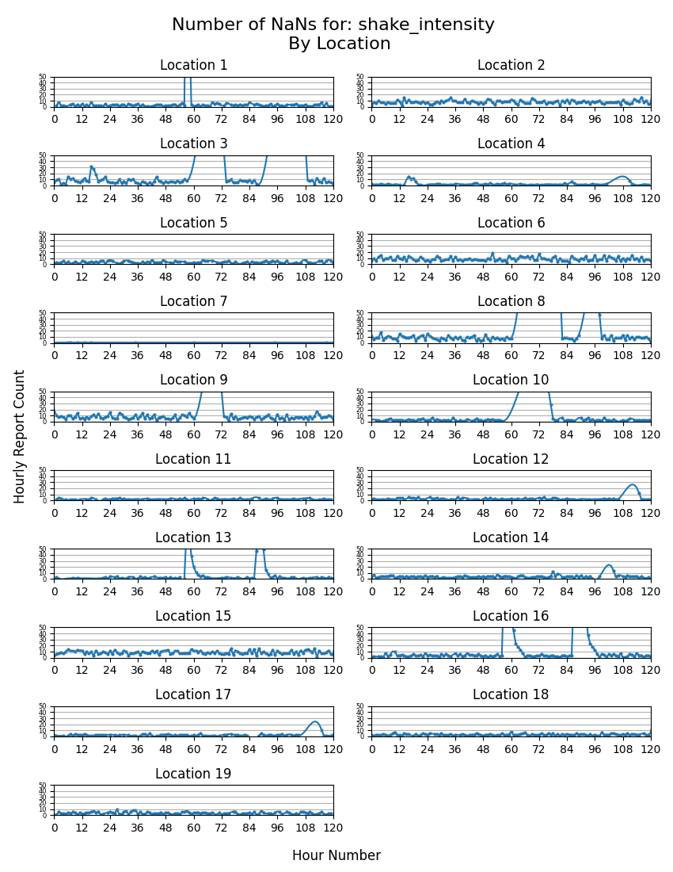
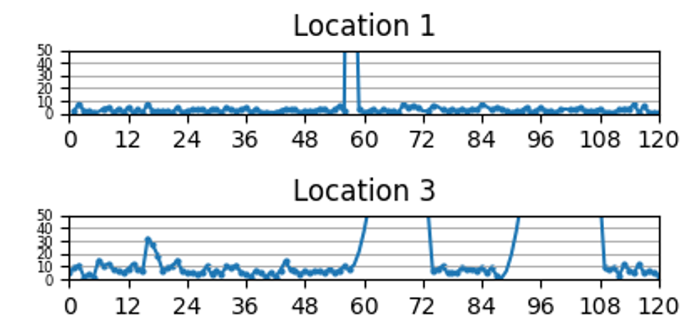
Shake Intensity NaNs Analysis
The full page of all 19 locations takes up an 8.5 x 11 sheet
Where the spline goes off the graph, there are many hours in a row with no NaNs (or no data due to power outage) recorded
Some locations have a spike in NaNs on the afternoon of April 6th. There is also a spike there in total reports counted
For the most part, all locations have a small, nonzero amount of unreported shake intensities across all hours suggesting some people just skipped that reporting option when the earthquake was not ongoing or recent
Looking at the total number of reports and the shake intensities of the reports helps add context to the NaNs

Slide 12
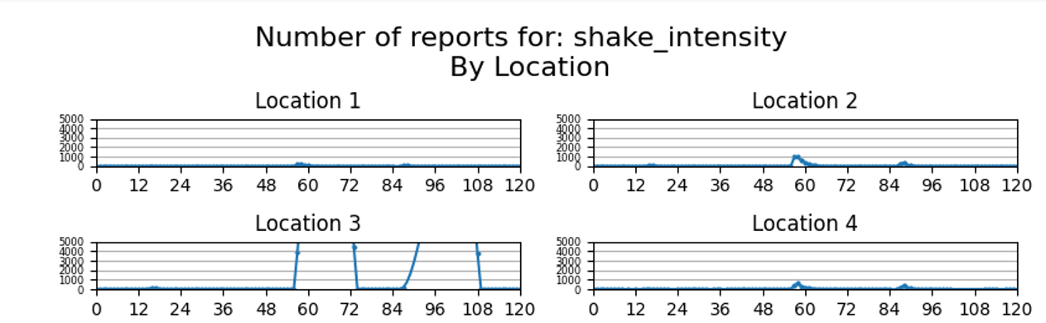
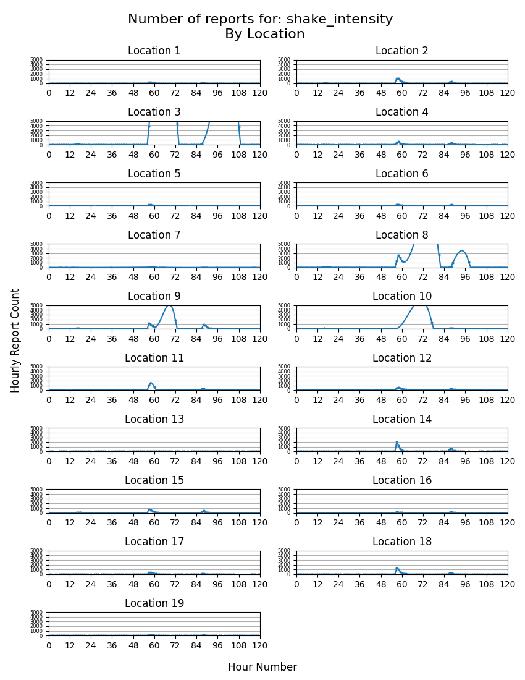
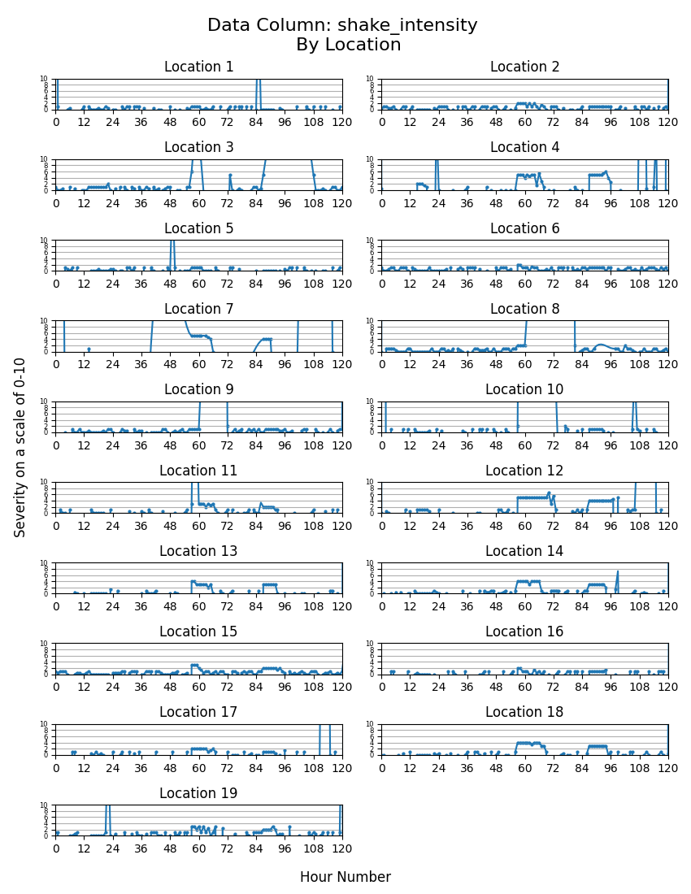
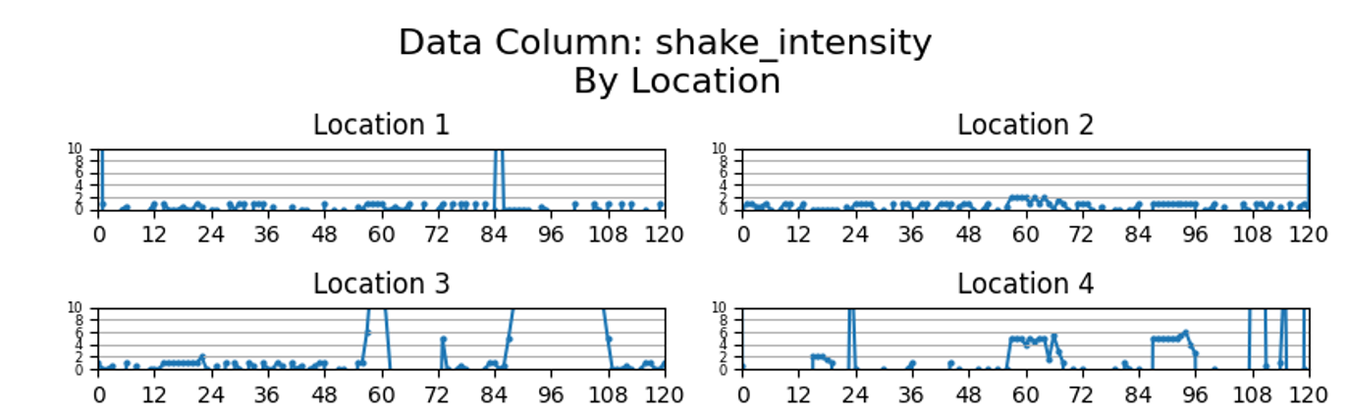
Spike in reports
At the same time, shake intensity reports get fairly consistent. This is when the first earthquake occurred

Slide 13
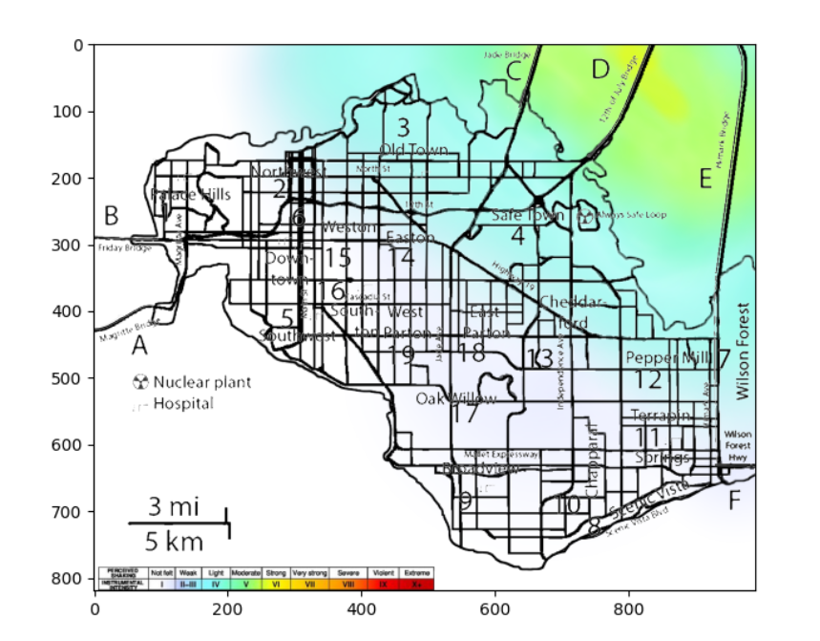
Continued Analysis
Using some image processing tricks, I overlaid the measured shake map over the numbered and labeled neighborhoods
From this, you can see that area 1 was almost completely spared, area 3 and 4 were among the strongest hit, and area 2 was in the middle.
Rather than use the full 8.5 x 11 of graphs for analyzing damage reports, I will stick with the first four locations for this presentation
Actual analysis covered all of them

Slide 14
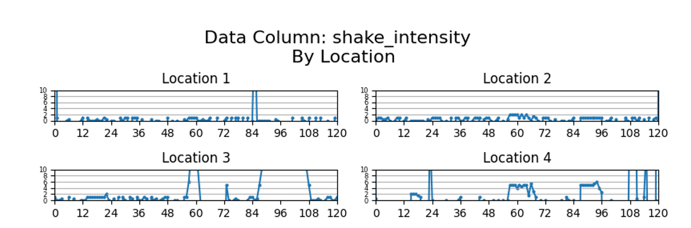
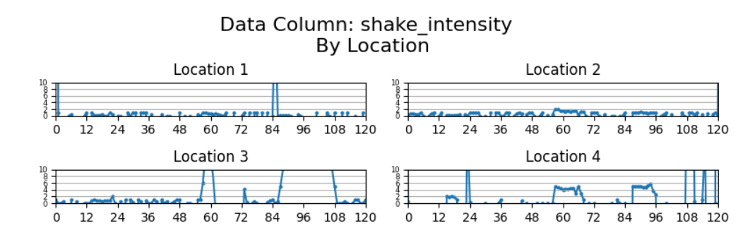
Damage Report Analysis
Hourly damage reports are on a scale of 0 to 10
The median value for the hour is shown
This is because some hours have very few reports and it rules out extremes from overly stoic or anxious people
Also, the shapes are comparable anyway and the median gives whole numbers
Median Shake Intensities
Mean Shake Intensities

Slide 15
Location 1 has low shake intensity the whole time, with consistent reports of intensity level 1 around hour 55 with a possible power/internet outage at hour 84
Location 3 has low shake intensity around hour 15, then middle intensity shaking at around hour 55. There is an outage from hours 59 to 72 and from around hours 86 to 108. Late reports arrive all at once at hour 73, 86, and 108
Location 2 and 4 report low and mid level shaking around hour 55. There isn’t an outage covering the entirety of each neighborhood, but areas seem to be reporting shaking data late between hours 86 and 96. Likely this is smaller areas within the neighborhoods getting power/internet restored

Slide 16
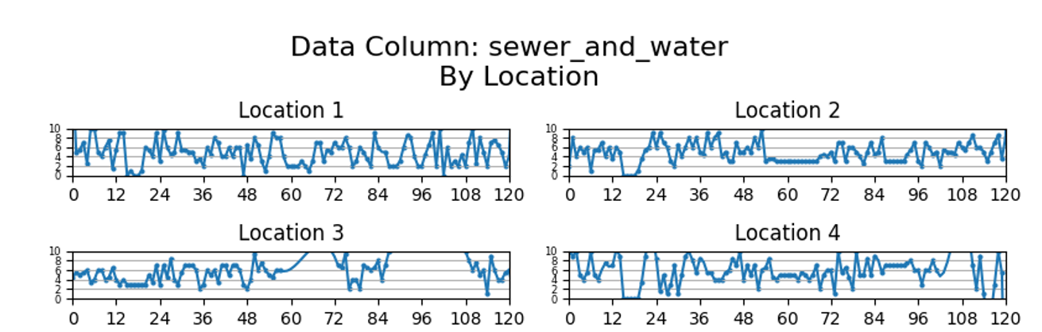
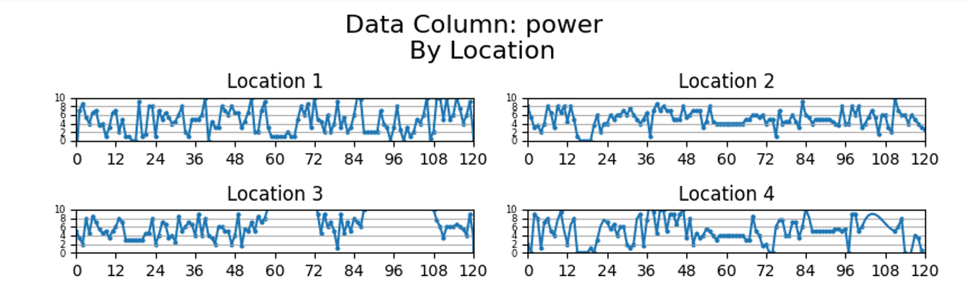
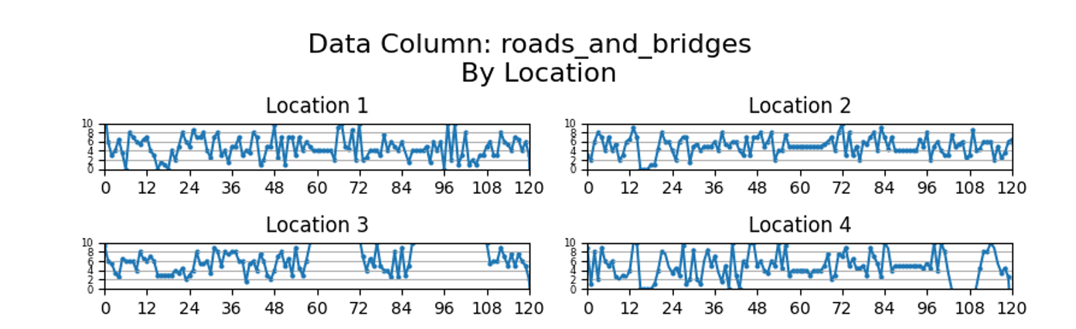
Similar patterns occur in the reports of the damage types
People are reporting damage before either of the earthquakes happen

Slide 17
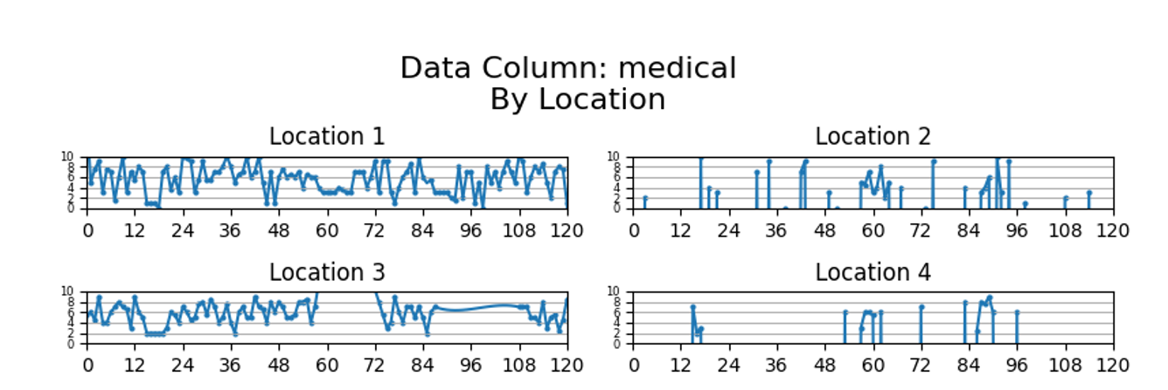
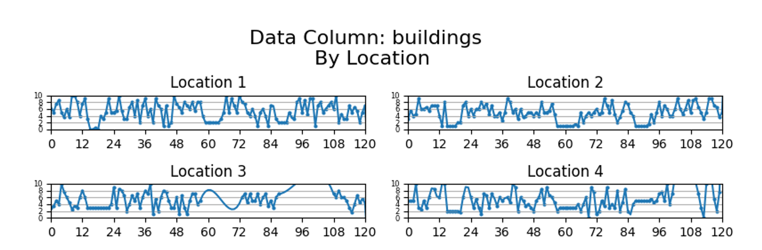
Neighborhoods 1 and 3 have a lot more medical facilities damage reports than Neighborhoods 2 and 4. This is because Neighborhoods 2 and 4 don’t have hospitals so they are likely reports from people near bordering neighborhoods with medical facilities that have damage

Slide 18
Insights From Damage Reports
People are reporting damage before the earthquakes happened so urgency assessment needs to consider a change in before and after
The earthquakes happened days ago and data from during the quake took over a day to arrive. Assessing current urgency of damage will need to consider only the most recent damage reports.
For future quakes, this system can be deployed shortly after the quake for more useful emergency response direction
Some areas of the city had roadwork, drainage work, powerline work, and other types of construction before the earthquake. By considering the change in damage reports over the period, the urgency should add more significance to new damage
The truthfulness of reports can be evaluated by comparing reported shake intensity in a neighborhood to the measured shake intensity from the shake map overlaid on the neighborhood map.

Slide 19
Urgency Evaluation
Damage urgency was evaluated by taking the mean of the last 12 hours of median damage reports. This value is current mean damage
From that, subtract the mean of the first 48 hours of median damage reports to get the change in damage.
Adjusted damage is current mean damage*(1+change in damage)
Max Measured Shake is added to Adjusted Damage to get Base Urgency
For roads and bridges damage, 2 is added to Base Urgency if the neighborhood has road access to the mainland

Slide 20
Urgency Evaluation
Base Urgency gets multiplied by location modifiers
Location 7 has a multiplier of 0 because it is mostly undeveloped
For medical facilities damage, neighborhoods without hospitals get a multiplier of 0
The Truthfulness Modifier is calculated by taking the difference between maximum reported shake intensity and maximum measured shake intensity (reported – measured), dividing that by 10, and subtracting it from 1
This gives a Truthfulness Modifier of 0.90 for locations that report a shake intensity of 1 over the measured shake intensity, 0.80 for locations that report a shake intensity of 2 over the measured shake intensity, 1.10 for locations that report a shake intensity of 1 under the measured shake intensity, etc.
The Base Urgency is then multiplied by the Truthfulness Modifier for the locations and damage types that did not get a multiplier of 0. This proportionally penalizes over-valuing and proportionally rewards under-valuing shake damage in the urgency calculation. This assumes the neighborhoods making those assessments are off in their values by similar amounts in the other types of reports.

Slide 21
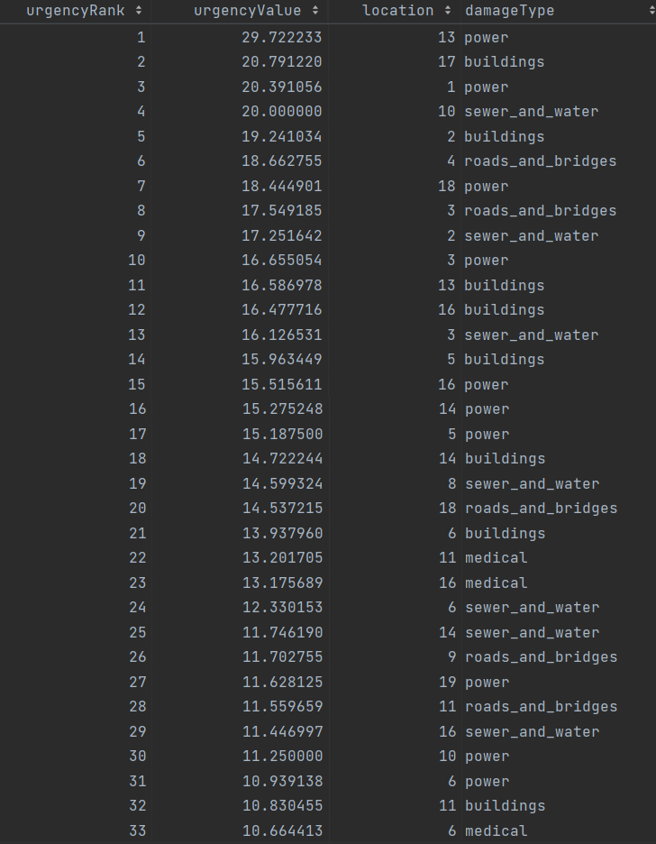
Results
The Nuclear Power Plant in Neighborhood 4 was in one of the highest shake intensity areas and gets its own Fire Department Emergency Response Team (FD-ERT)
That leaves 33 FD-ERTs to assign to various locations and damage types
Areas 7, 12, and 15 have no damage in the top 33 urgent damage reports

Slide 22
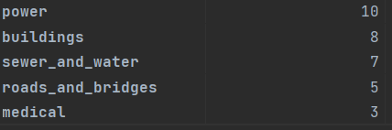
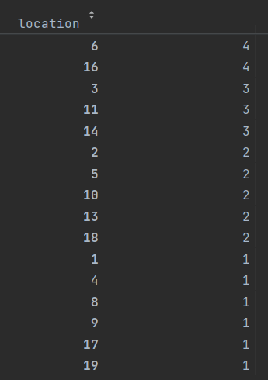
Results
Location 2 under-valued shaking intensity by 1
Locations 3, 4, 14, 15, 18, and 19 over-valued shaking intensity by 1
Location 12 over-valued shaking intensity by 2.5

Slide 23
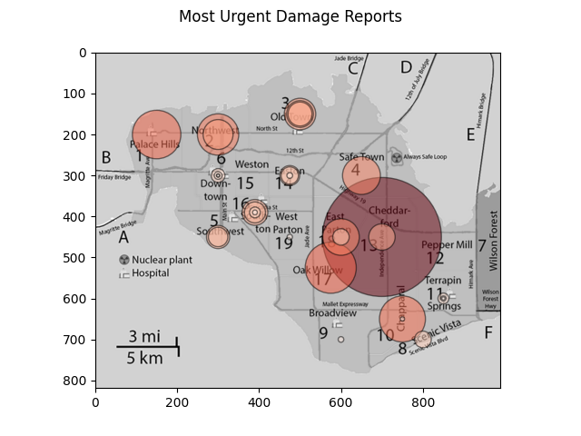
Results
Despite Neighborhoods 3 and 4 having some of the highest intensity shaking, there are several damage reports more urgent in other Neighborhoods. This could be due to better construction or a flaw in the urgency evaluation
It would be more useful to use data just after the earthquake when more people are making damage reports but with this earthquake occurring days ago it doesn’t make sense to.

Slide 24
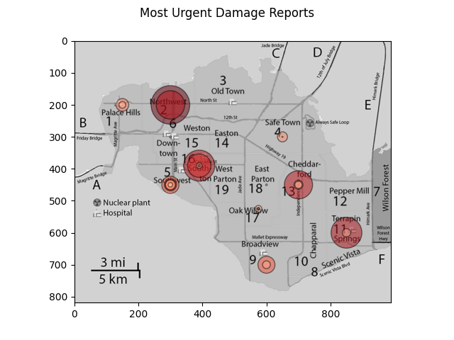
I changed the current mean damage value to max reported median damage report between hours 48 and 108 and the urgency map changed to this, suggesting even less urgency in Neighborhoods 3 and 4
The description of Neighborhood 3 (Old Town) is it is historic brick buildings suggesting sturdy construction that has outlasted multiple earthquakes
The description of Neighborhood 4 (Safe Town) is older single-family homes that may also have survived past earthquakes.
Otherwise, the urgency calculation needs to give more weight to shake intensity of the earthquake

